Slide 1
Peracetic Acid Gas Plasma Sterilisation
16th WFHSS in Lille
9th Oct. 2015 14:15-14:40
Tokyo Healthcare University Postgraduate School
Kobayashi H, Yoshida R, Endo H, Yoshida Y, Nakamura E
Conflict of interest statement
HK is consultant for Yoshida Pharm., Saraya and Sakura, and HE, YY and EN are employees of Saraya.
Funding sources
None

Slide 2
CDC Guideline for Disinfection and Sterilization
in Healthcare Facilities, 2008
Peracetic Acid Sterilization
Overview. Peracetic acid is a highly biocidal oxidizer that maintains its efficacy in the presence organic soil. Peracetic acid removes surface contaminants (primarily protein) on endoscopic tubing.
An automated machine using peracetic acid to sterilize medical, surgical, and dental instruments chemically (e.g., endoscopes, arthroscopes) was introduced in 1988. This microprocessor-controlled, low-temperature sterilization method is commonly used in the United States . The sterilant, 35% peracetic acid, and an anticorrosive agent are supplied in a single-dose container. The container is punctured at the time of use, immediately prior to closing the lid and initiating the cycle. The concentrated peracetic acid is diluted to 0.2% with filtered water (0.2 µm) at a temperature of approximately 50℃.

Slide 3
Peracetic Acid
Advantages ·
Rapid cycle time (30-45 minutes)
Low temperature (50-55℃) liquid immersion sterilization
Environmental friendly by-products
Sterilant flows through endoscope which facilitates salt, protein and microbe removal
Disadvantages
Point-of-use system, no sterile storage
Biological indicator may not be suitable for routine monitoring
Used for immersible instruments only
Some material incompatibility (e.g., aluminum anodized coating becomes dull)
One scope or a small number of instruments processed in a cycle
Potential for serious eye and skin damage (concentrated solution) with contact

Slide 4
FDA Safety Alert: Warning Regarding the Use of the AbTox Plazlyte™ Sterilization System
(You are encouraged to copy and distribute this alert.)
April 13, 1998
To: Users of the AbTox Plazlyte™ Sterilization System
FDA is alerting the health care community not to use the AbTox Plazlyte™ Sterilization System for ophthalmic
instruments, and is providing clarification regarding the recall of this device and recommending options for
alternative sterilization.

Slide 5
AbTox, Inc., of Mundelein, Illinois, issued a voluntary recall on March 31, 1998, to all owners of the AbTox Plazlyte™
Sterilization System. This recall notice said not to use the system on ophthalmic instruments or on any other
instruments made with brass, copper or zinc, or which had been soldered. FDA is warning hospitals and physicians
against the use of the AbTox Plazlyte™ Sterilization System because of serious eye injuries, including the need for
corneal transplantation in some patients, following use of ophthalmic surgical instruments which had been sterilized
with the system. The problem appears to be deposits of copper and zinc salts on devices sterilized with this system.
Copper compounds are toxic to human corneal endothelial cells.

Slide 6
Peracetic Acid （PAA）
Excellent disinfection and cold sterilization activity of PAA has already been reported by Freer and Novy in 1902.
Freer, P. C. and Novy, F. G. (1902) On the formation, decomposition and germicidal action of benzoylacetyl and diacetyl peroxides. Am. Chem. J. 27: 161-193.
High concentration PAA products have a strong irritating smell and a low flash point (56℃), making them difficult to handle. Thus, for practical use as a disinfectant, there was a need to develop a low concentration PAA solution (that is, an equilibrium solution of peracetic acid, hydrogen peroxide, acetic acid, and water).
Low concentration PAA solutions have been used as medical device disinfectants for more than 10 years.

Slide 7
Peracetic Acid （PAA）
Superiority in reprocessing medical instruments
Wide antibacterial spectrum
Short contact time
Decomposition products are non-toxic
Compared to a similar oxidizing chemistry, hydrogen peroxide, exhibits equivalent or greater germicidal efficacy at lower concentrations.
Concentrations required for high-level disinfection and sterilisation :
Hydrogen Peroxide: 6% and greater
Peracetic Acid: 0.2～0.3%

Slide 8
Low Temperature Gas Plasma Sterilisers
Low temperature hydrogen peroxide gas plasma method
STERRAD ® （Johnson & Johnson）
PLAZTEK® (HUMANMEDITEK, Korea）
V-PRO™ (STERIS)
Low temperature peracetic acid gas plasma method
AbTox Plazlyte™ Sterilisation System（Abtox, currently discontinued）
REVOX ®Technical Bulletin, July 2011 Vol. 1, no. 1
STERIACE ®（SARAYA Co., Ltd.）

Slide 9
Superiority of Peracetic Acid Vapor
Resistance of Spores to Chemicals
Chemical | Organism | Kill | Time (h) | Conc. (% w/v) | Temp. (ºC) | Reerencef
Peracetic acid vapor | B. Subtilis var. niger | 10⁵ | 0.02 | 0.0001 | 25 | Portner and Hoffman (1968)
Ethylene oxide | B. Subtilis | 10² | 0.7 | 0.07 | 40 | Marletta and Stumb (1970)
Hydrogen peroxide | B. Subtilis var. globiggi | 10³ | 0.17 | 25.8 | 24 | Toledo et al. (1973)
Hypochlorous acid | B. Subtilis | 10³ | 2.0 | 0.01† | 10 | Dye and Mead (1972)
Glutaraldehyde | B. pumilis | 10³ | 0.5 | 2.0 | 37 | Thomas and Russell (1974)
Formaldehyde | B. Subtilis var. niger | 10³ | 1.5 | 1.0 | 40 | Trujillo and David (1972)
Iodine (as iodophor) | B. Subtilis | 10² | >4.0 | 0.08 | 21 | Cousins and Allan (1967)
† Free chlorine
Waites WM, Resistance of bacterial spores. In Principles and Practice of Disinfection, Preservation, and Sterilization. Edited by AD Russell and GAJ Ayliffe. Oxford, Blackwell Scientific Publications, p.221, 1982.

Slide 10
Superiority of Peracetic Acid Vapor
The Effect of Peracetic acid Vapor on Bacillus subtilis var. niger Spores at 80% Relative Humidity and 25ºC; Spores on Paper and Glass; 1 mg/L Peracetic Acid (N=16)
Exposure (Minutes) | Paper |  |  | Glass
 | Active Spores | Sterile samples |  | Active Spores | Sterile samples
0 | 816,000 | ― |  | 816,000 | ―
1.25 | 676 | 0 |  | 5 | 7
2.5 | 1 | 5 |  | 2 | 7
5 | < 1 | 12 |  | < 1 | 13
10 | < 1 | 14 |  | < 1 | 13
20 | 0 | 16 |  | < 1 | 10
Portner DM and Hoffman RK, Sporicidal effect of peracetic acid vapor. Appl Microbiol 1982;16:1782.

Slide 11
Peracetic Acid Gas Plasma Sterilisation（PAGS) (STERIACE®） Why Peracetic Acid?
Effective against a wide range of microorganism at concentrations lower than hydrogen peroxide
Peracetic acid has excellent germicidal action even in vapour form
No appearance of resistant bacteria

Slide 12
Appearance of Peracetic Acid-resistant Bacteria
Since 1902 when peracetic acid was first reported to have disinfectant properties until now, there have been no reports in literature of peracetic acid-resistant bacteria.
It is believed that because peracetic acid causes a wide variety of chemical reactions and acts on various sites, it is difficult for bacteria to gain/develop resistance to Peracetic acid.

Slide 13
the National Advisory Committee
for Acute Exposure Guideline Levels for Hazardous Substances (NAC/AEGL Committee)
Acute Exposure Guideline Levels
for Selected Airborne Chemicals: Volume 8.
National Research Council (US) Committee
on Acute Exposure Guideline Levels.
Washington (DC): National Academies Press (US); 2010.

Slide 14
Parameter | Data | Reference
Chemical Name | Peracetic acid | O’Neil et al. 2001
CAS Registry No. | 79-21-0 | RTECS 2003
Chemical Formula | CH₃COOOH | O’Neil et al. 2001
Molecular Weight | 76.05 | O’Neil et al. 2001
Physical State | Colorless liquid | Lewis 1993
Boiling/Freezing/Flash Point | 105 °C/−30 °C/40.5 °C | Lewis 1993
Density | 1.15 at 20 °C | Lewis 1993
Solubility | Freely soluble in H₂O, alcohol, ether, H₂SO₄ | O’Neil et al. 2001
Vapor Pressure | 14.5 mm Hg at 25°C | HSDB 1997
Explosion point | 110 °C | Lewis 1993
Henry’s Law Constant | 2.08 × 10⁻⁶ atmm³/mol at 25 °C | HSDB 1997
Conversion factors | 1 ppm= 3.04 mg/m³ at 20 °C and 101kPa | IUCLID 2000

Slide 15
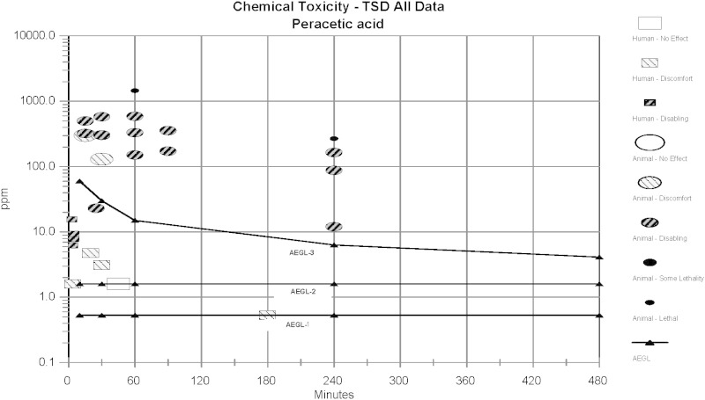

Slide 16
Summary of AEGL Values for Peracetic Acid
Classification | 10 min | 30 min | 1 h | 4 h | 8 h | End Point /Reference
AEGL-1 (Nondisabling) | 0.52 mg/m³ (0.17 ppm) | 0.52 mg/m³ (0.17 ppm) | 0.52 mg/m³ (0.17 ppm) | 0.52 mg/m³ (0.17 ppm) | 0.52 mg/m³ (0.17 ppm) | Threshold for irritation (Fraser and Thorbinson 1986; McDonagh 1997)
AEGL-2 (Disabling) | 1.6 mg/m³ (0.5 ppm) | 1.6 mg/m³ (0.5 ppm) | 1.6 mg/m³ (0.5 ppm) | 1.6 mg/m³ (0.5 ppm) | 1.6 mg/m³ (0.5 ppm) | Mild irritation (Fraser and Thorbinson 1986)
AEGL-3 (Lethal) | 60 mg/m³ | 30 mg/m³ | 15 mg/m³ | 6.3 mg/m³ | 4.1 mg/m³ | Highest concentration causing no deaths (Janssen 1989a)
AEGL-3 values are based on exposure to aerosol; therefore, concentrations are not converted to ppm.

Slide 17
Objects to be sterilised
＜Compatible＞
＜Incompatible＞
Metals
Stainless steel, Aluminum
Resins
Acrylic, Nylon, PET,
Polystyrene, PVC, ABS,
Polysulfone, PC, PE, PP,
Acetal, PTFE, Polyamide
Rubber
Silicon rubber
Metals
Brass, Copper, Carbon steel
Rubber
Neoprene rubber,
Natural rubber,
Ethylene-propylene rubber
Adhesives
Epoxy resin

Slide 18
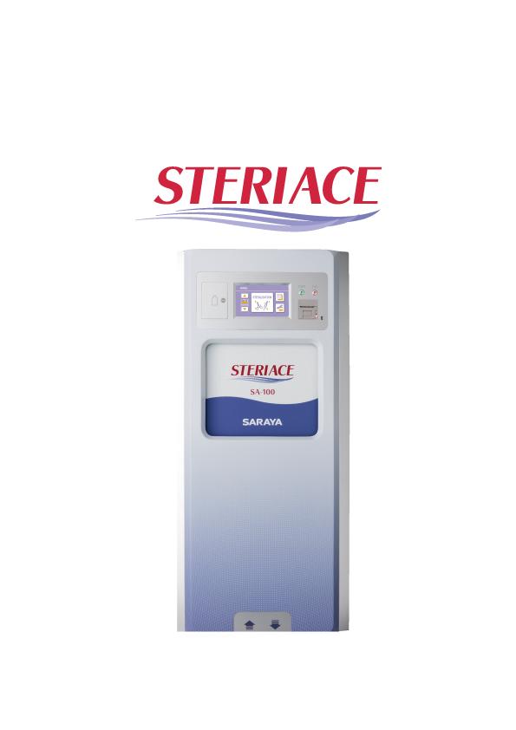
Equipment used
■Product name ：
STERIACE100®
■Use ：
Sterilization of medical equipment
■Size ：
W 760×D 980×H 1720 ㎜
■Used chemical ：
Peracetic Acid
Concentration of Peracetic Acid :6% usually
■Volume of tank ：
app.100L

Slide 19
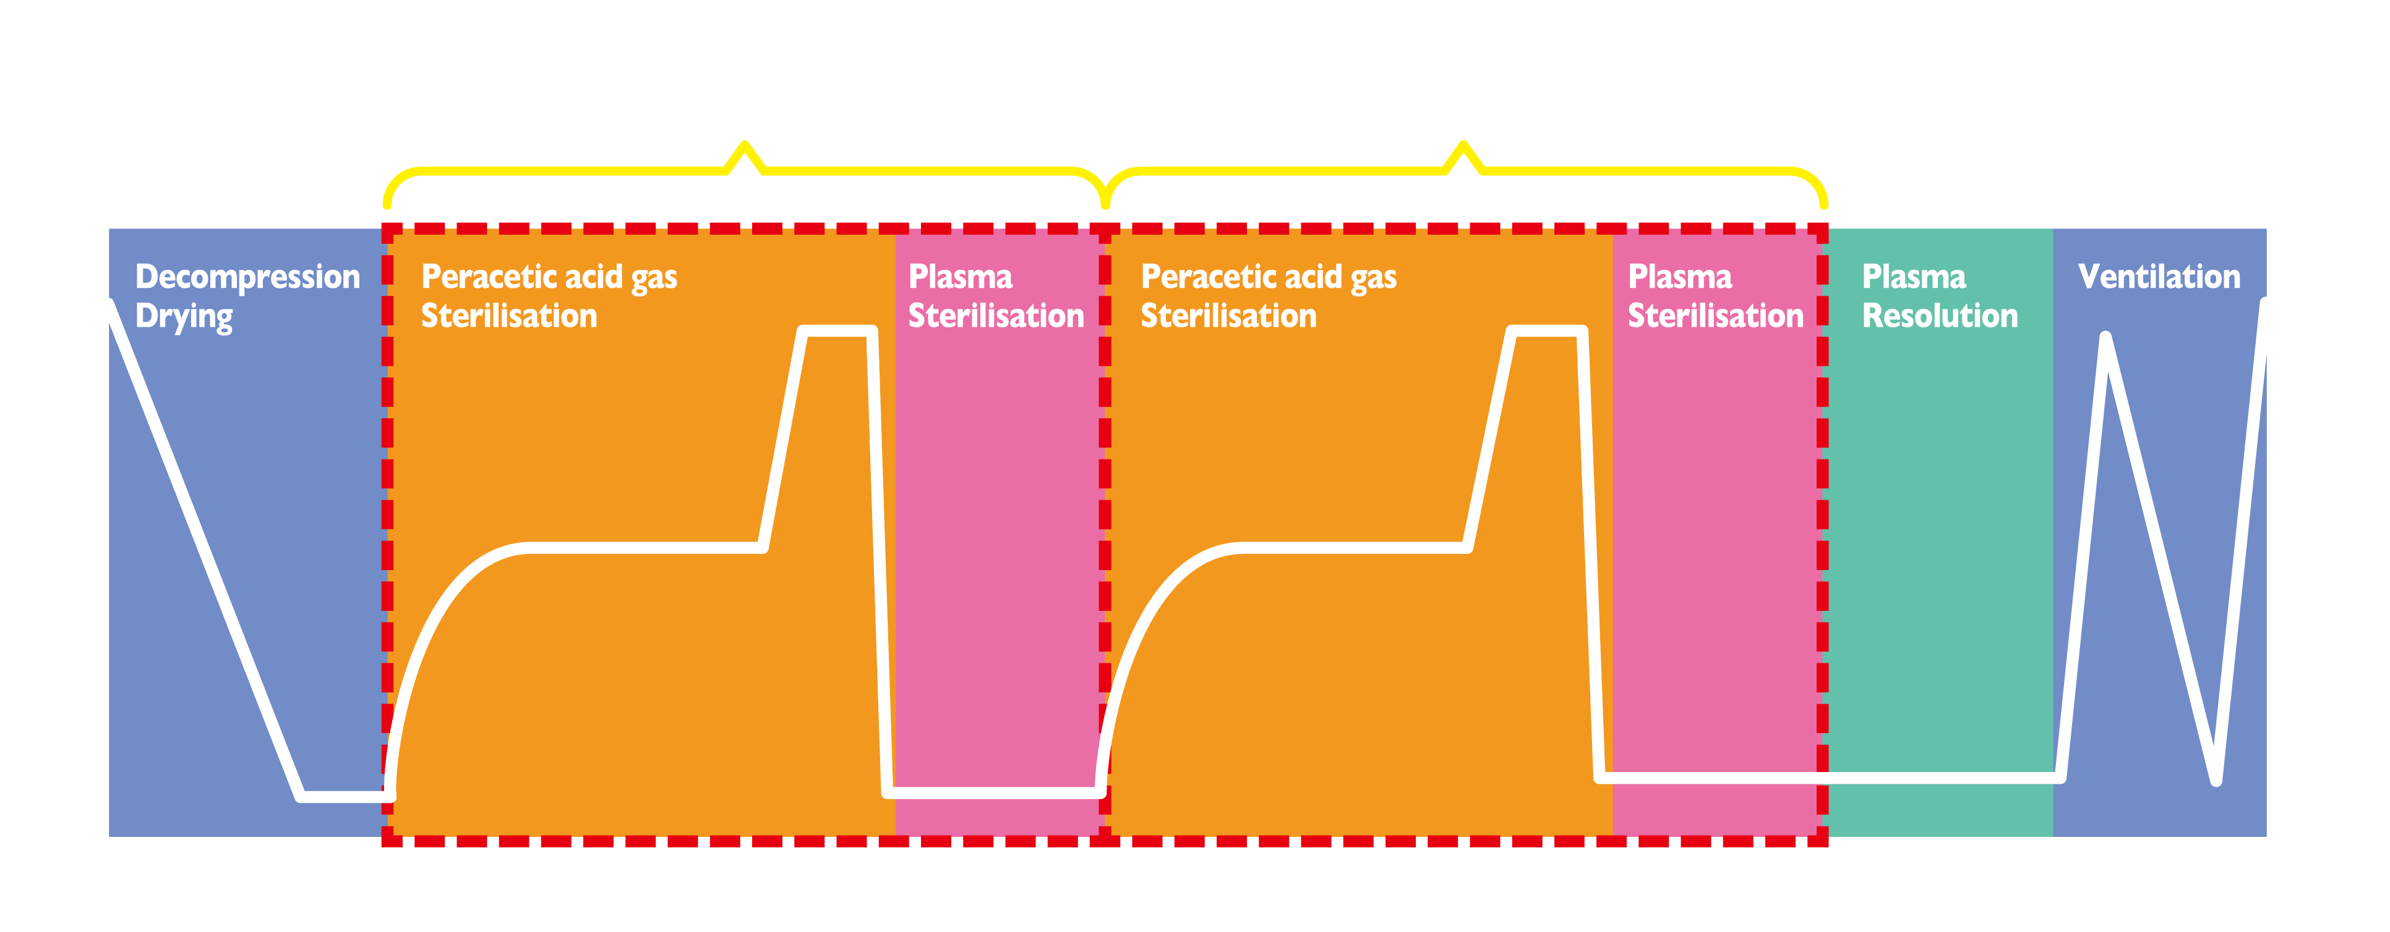
Sterilisation Process
Peracetic acid gas plasma sterilisation has 2 parts:
Sterilisation by peracetic acid gas and Sterilisation by plasma

Slide 20
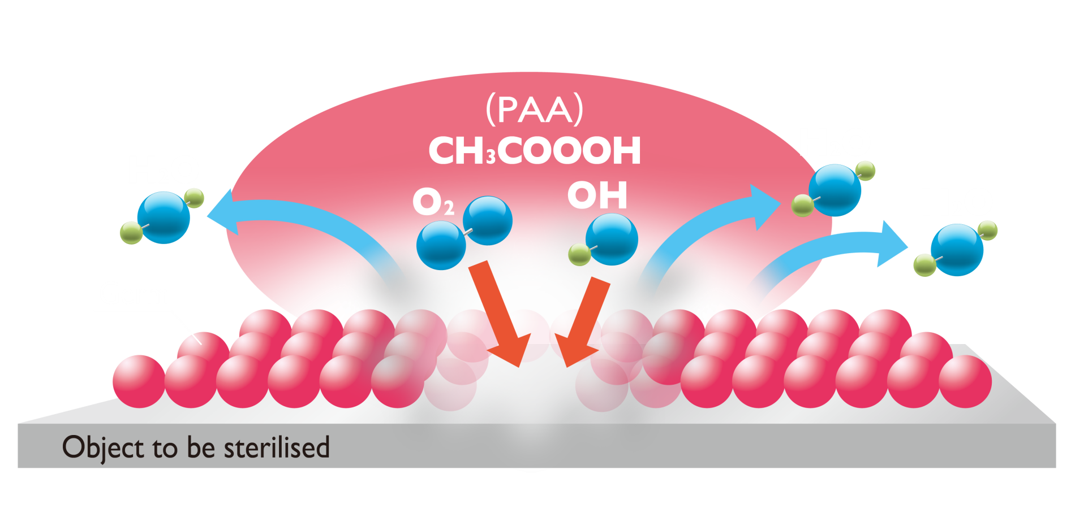
Peracetic Acid Sterilisation Mechanism
Germicidal action of Peracetic acid
With its oxidizing power, PAA kills germs by destroying cell
proteins and inhibiting cellular transport of metabolites.
Radicals produced from PAA（OH and O radicals）
are considered to be the main component of germicidal
activity.
Point
PPA is more effective than hydrogen peroxide at lower concentrations because it has stronger oxidizing power.

Slide 21
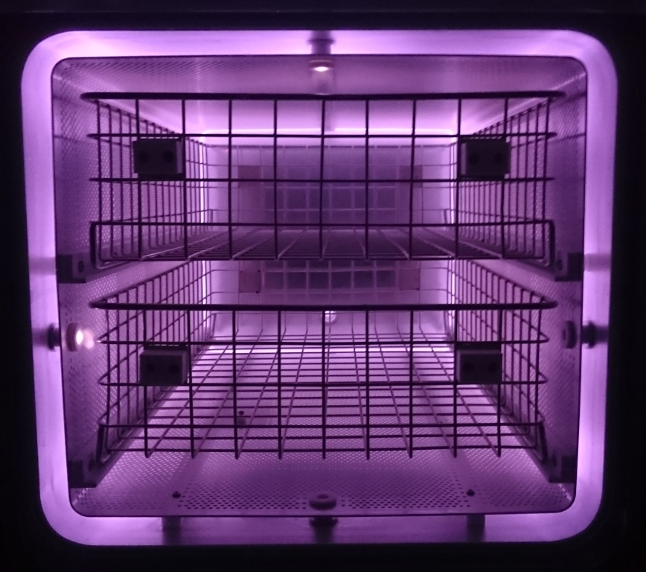
Plasma Sterilisation Mechanism
The plasma is produced between an electrode and chambers.
RF Power
Electrode
Ultraviolet rays are included in the plasma emission.
Ground
Chamber
Electrode
Notes:
プラズマは電極とチャンバーの間で生成されます。（写真のように被滅菌物を設置するカゴ部を囲むように生成されます。）
紫外線はプラズマの発光に含まれており、プラズマが生成されると生じます。
滅菌工程の図では、「Plasma sterilisation」のパートでプラズマが生成され、紫外線が照射されます。

Slide 22
Plasma Sterilisation Mechanism
Chamber (Ground)
Chamber (Ground)
Electrode
Electrode
Ground
RF Power
RF Power
Ground
Electro-magnetic field
Plasma
Ⅰ. When a high-frequency voltage is applied to the electrode, the electro-magnetic field is produced between an electrode and chambers.
Ⅱ. Particles in gas are ionizes by receiving energy from an electromagnetic field. And plasma is produced.
Notes:
＜プラズマの生成方法＞
Ⅰ．電極に高周波電圧（ＲＦ）を印加し、チャンバーとの間に高エネルギーの電磁場を生成します。
Ⅱ．電磁場のエネルギーを受けて、気体中の粒子は電離され、プラズマが生成されます。
※ＲＦとは、「Radio Frequency」 の略で、高周波の意味です。

Slide 23
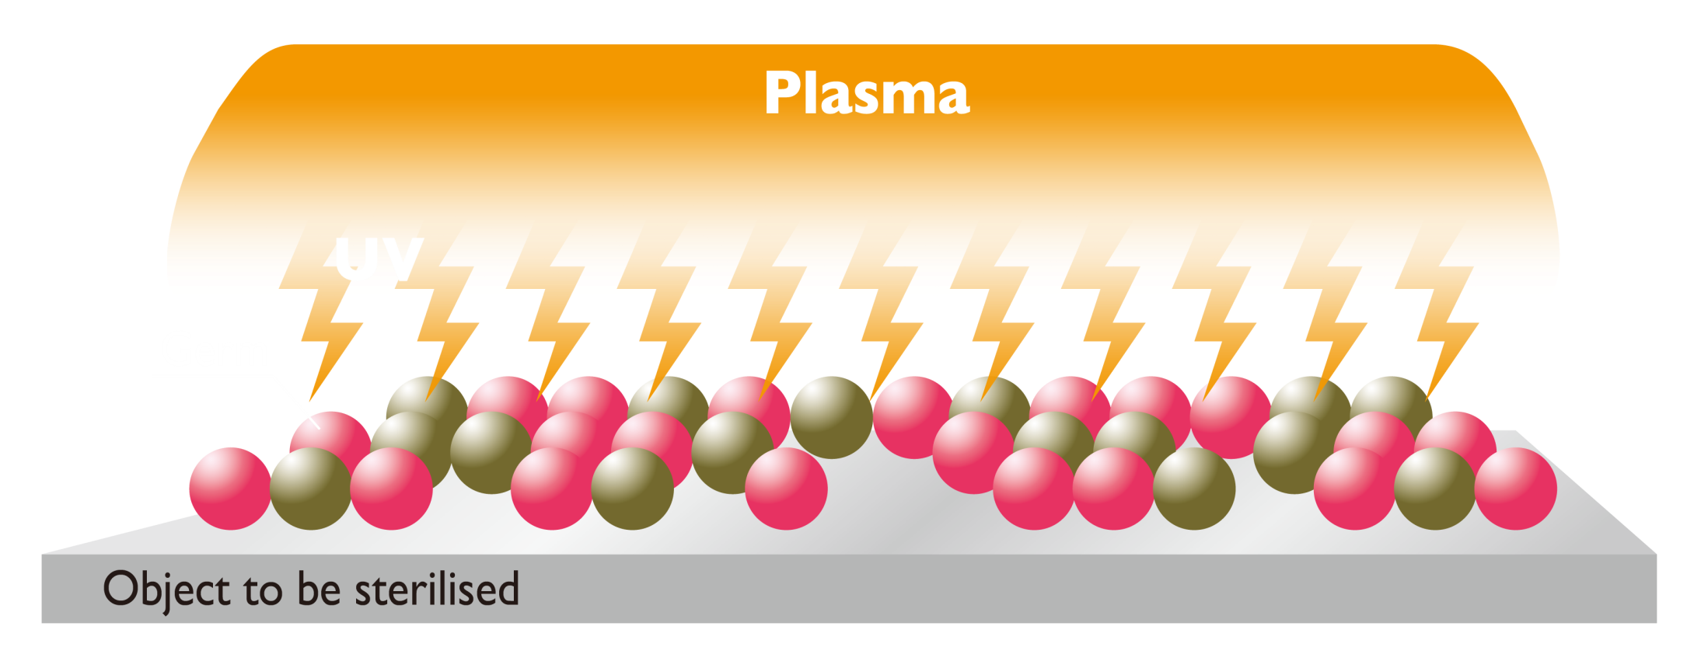
Plasma Sterilisation Mechanism
Germicidal action of Ultraviolet (UV) radiation
UV light with a wavelength of 200nm～300nm acts on
the DNA of germs, and kills them.

Slide 24
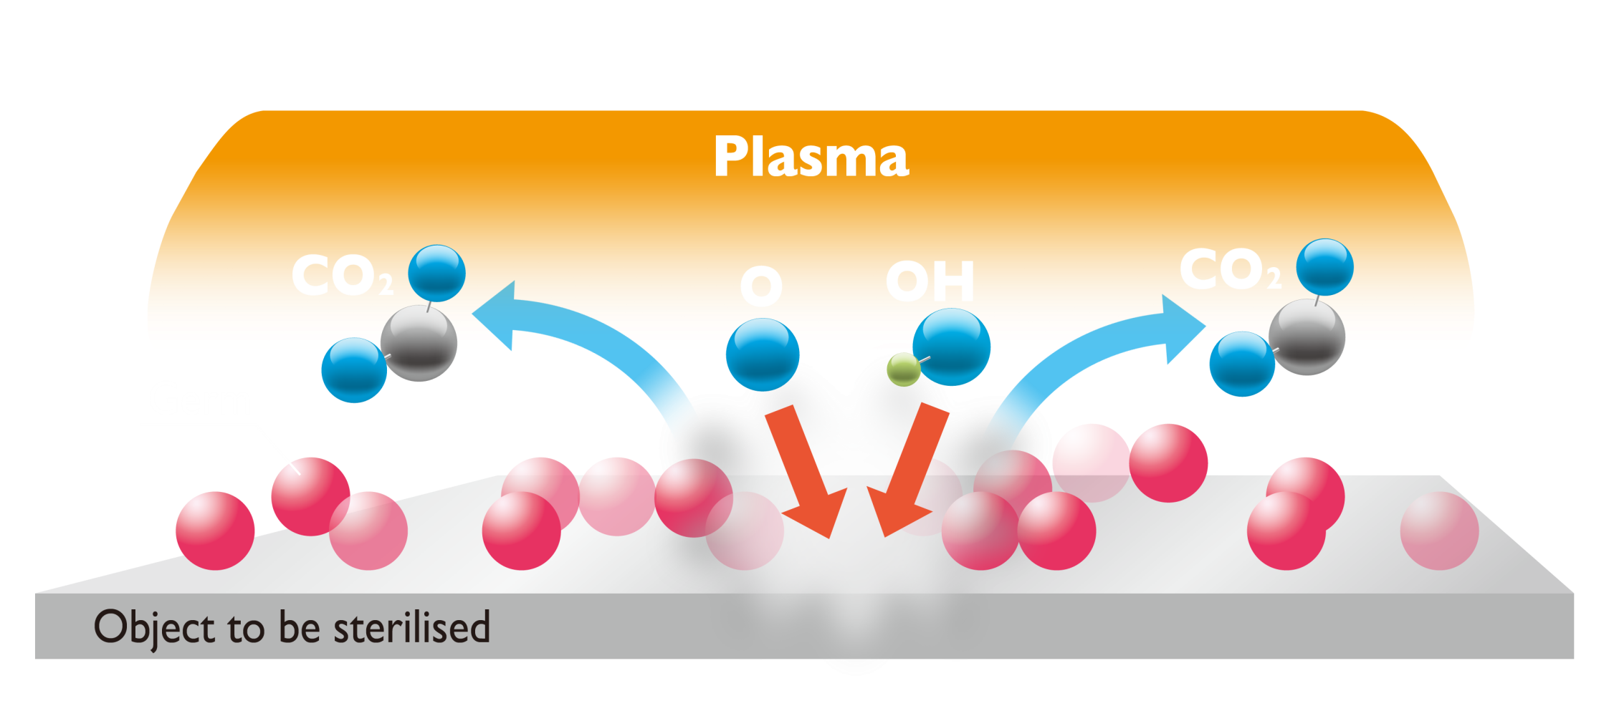
Plasma Sterilisation Mechanism
Germicidal action of Radicals
By their oxidizing action, O radicals and OH radicals
inactivate the cell walls and proteins of germs.

Slide 25
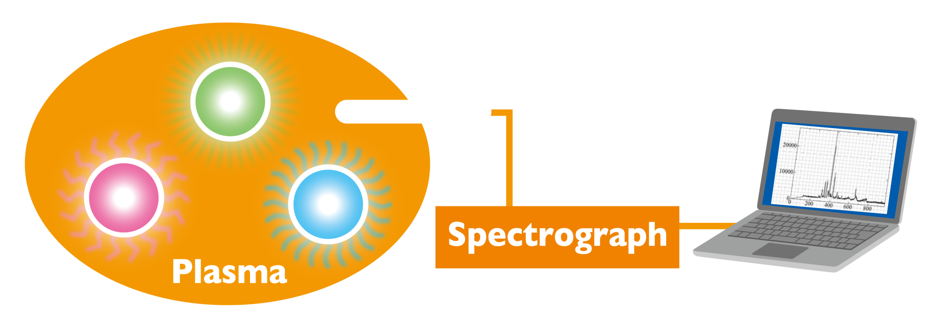
Analysis of Plasma Components
by Emission Spectroscopy
Emission spectroscopy measures specific wavelengths of light emitted by ions and particles generated within plasma, and is a method of estimating the type and density of particles.
Notes:
空気のみを媒体としたプラズマと、過酢酸混合（空気も含みます）ガスを媒体としたプラズマの発光スペクトルを比較し、プラズマで生成される成分の違いを確認しました。意図としては、過酢酸を付加することで、滅菌に有効なラジカルが生成されることを確認することが目的です。

Slide 26
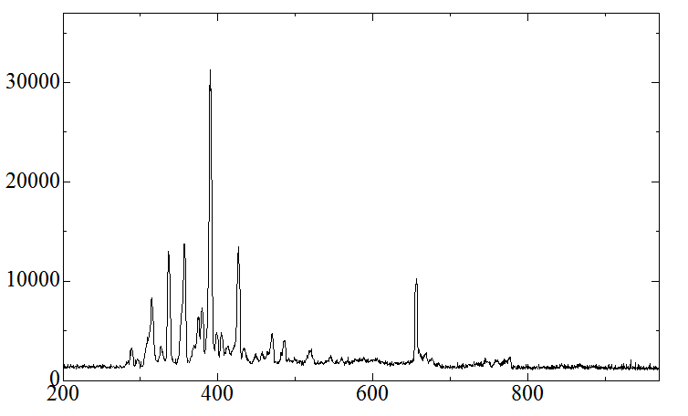
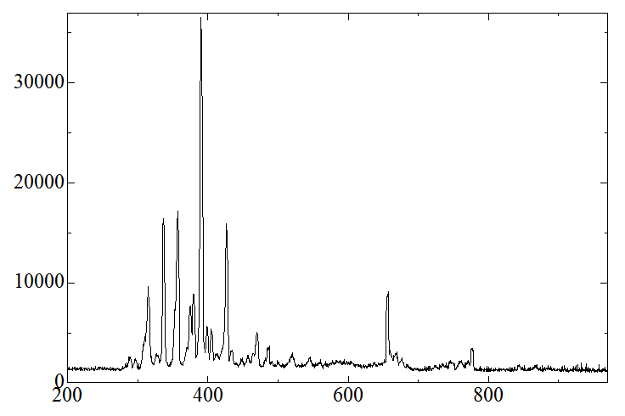
Analysis of Plasma Components
by Emission Spectroscopy (Sterilisation Process)
＜ Emission spectrum of air plasma＞
Emission intensity [a.u.]
N,N₂, etc.
Hα
Wavelength[nm]
＜Emission spectrum of PAA plasma (10 second irradiaion)＞
Emission intensity [a.u.]
N,N₂, etc.
Hα
O radical
Wavelength[nm]
Notes:
空気のみを媒体としたプラズマと、過酢酸混合（空気も含みます）ガスを媒体としたプラズマの発光スペクトルを比較し、プラズマで生成される成分の違いを確認しました。意図としては、過酢酸を付加することで、滅菌に有効なラジカルが生成されることを確認することが目的です。
過酢酸を付加した際のプラズマの発光スペクトルを確認したところ、空気媒体のプラズマではほとんど生成されていなかった酸素ラジカルが生成されていることがわかります。
この結果より、過酢酸を付加したプラズマは滅菌に有効であると言えます。

Slide 27
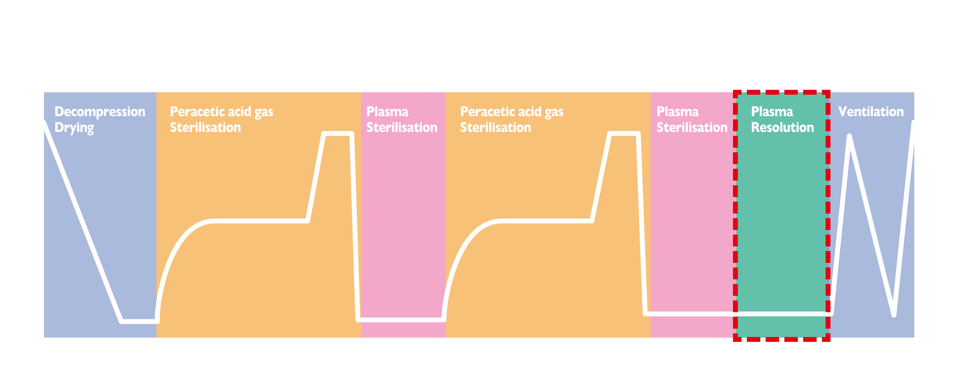
Decomposition of Peracetic Acid by Plasma

Slide 28
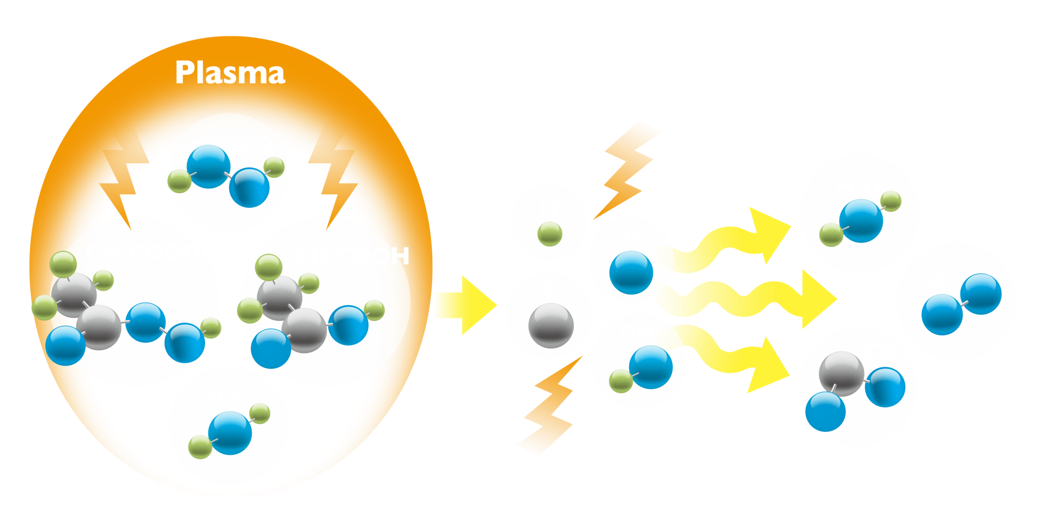
Decomposition of Peracetic Acid by plasma
Germicidal action of radicals
In plasma, in addition to radicals and UV light, high-energy
electrons and ions are also present.
These act on peracetic acid, decomposing PAA at the atomic level
changing it into harmless components.
Notes:
プラズマ分解工程では、過酢酸ガス中にプラズマを生成することで、薬剤成分を原子レベルに分解することが期待されます。

Slide 29
Decomposition by Plasma
Plasma decomposition effect was investigated by
changing the plasma irradiation time on peracetic
acid.
As a confirmatory method, the emission spectrum
of Carbon (which is formed when Peracetic acid
decomposes) was observed.

Slide 30
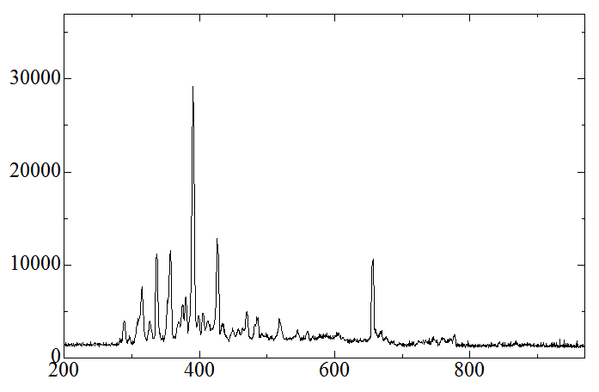
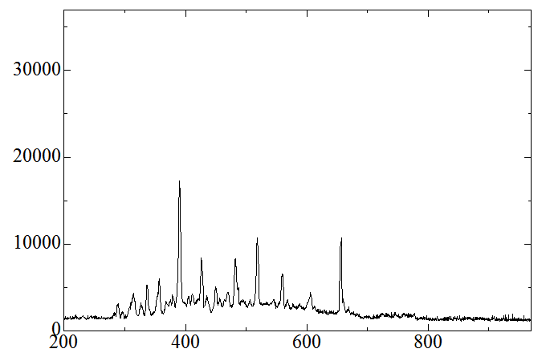
Analysis of Plasma Components
by Emission Spectroscopy (Decomposition Process)
＜Emission spectrum (1 minute process time) of PAA plasma＞
Emission intensity [a.u.](arbitrary units)
N,N₂, etc.
Hα
C radical
2015/10/8
Wavelength[nm]
＜Emission spectrum (5 minute process time) of PAA plasma ＞
Emission intensity [a.u.]
N,N₂ , etc.
C radical
Hα
Wavelength[nm]
Notes:
過酢酸ガス中でプラズマを1分間照射した時と、5分間照射した時の発光スペクトルを比較しました。意図としては、処理時間が増すにつれて過酢酸が分解されることを確認することが目的です。
確認方法として、過酢酸が分解して生じる炭素のスペクトルの発光強度を比較します。
この結果より、プラズマ処理時間が長くなるにつれて炭素の発光強度が増すことが分かります。

Slide 31
Emission Intensity of Carbon Radicals
Emission intensity [a.u.]
Treatment Time[min]
Notes:
本グラフは、プラズマ処理時間を0分（空気プラズマ）、1分、3分、5分と変化させた時の炭素の発光強度を示しております。
プラズマ処理時間が増えるにつれて炭素発光強度が強くなることがわかります。
同条件下での連続測定で発光強度が増えるということは、時間変化に応じて炭素の量が増加していると言えます。
炭素が増加するということは、過酢酸、酢酸が分解されていると言えます。

Slide 32
Decomposition by Plasma
From the measurement results, it can be seen
that as the plasma irradiation time is increased,
the emission intensity of the carbon emission
spectrum (517nm) also increases.
From this fact, it can be seen that peracetic acid
is decomposed at the atomic level by plasma.
Notes:
本データにより、滅菌に使用した過酢酸は、プラズマで処理することにより原子レベルまで分解することができると言えます。
このプラズマ分解工程で本装置のチャンバー内の残留薬剤は、水や酸素、二酸化炭素などに分解され無害化されます。

Slide 33
Validation of Starilisation Process
Half Cycle Method
＜Test Method＞
Chemical solution
・PAA formula
Biological indicator(BI)
・ACE Test®(Self-Contained BI, FUKUZAWA）
・Filament BI（Polyester Sutures, MesaLabs)
G. stearothermophilus ATCC7953 (10⁶ count）
BI was set in the chamber and run the half cycle.
sporicidal activity was checked by positive or negative.
Notes:
33
Protest(培地一体型）をそのまま庫内にセット（10本×3回、13本×1回）し、
ハーフサイクルで処理した。その後、手順書に従い培養した後、培地の色の変化で陽性・陰性を確認した。
また、ポリエステル糸状BIにおいても、滅菌バックに入れた状態で庫内（1本×30回）にセットし、ハーフサイクルで処理した。
そのまま手順書に従い、培地に加えて培養し、培地の濁りで陽性・陰性を確認した。

Slide 34
Validation by Half Cycle Method
BI type | N | positive or negative
ACE test® | 43 | all negative
Filament BI | 30 | all negative
Notes:
34

Slide 35
Sporicidal Activity of PAA Solution (Results)
The peracetic acid and hydrogen peroxide concentration and the sporicidal activity in the chamber are shown below:
PCD：PTFE tube (φ1mm:1,000mm)+Filament BI
Peracetic Acid concentration (changed) | Hydrogen Peroxide concentration (fixed) | Survivor count (CFU/BI)
8 g/m³ | 10 g/m³ | ＜10
5 g/m³ | 10 g/m³ | ＜10
2.5 g/m³ | 10 g/m³ | 9.8×10³
0 g/m³ | 10 g/m³ | 3.9×10⁵
*All are below detection limits if BI only.
Notes:
35

Slide 36
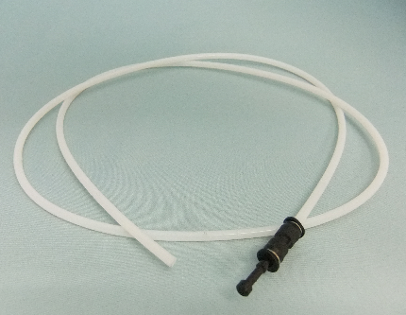
Sporicidal Activity of PAA in Narrow Channels
＜Test Method＞
Chemical solution used for steriliser preparation
・PAA formula (Commercial product PAA：15%, Hydrogen
peroxide 22%)
・Hydrogen peroxide (35%)
Using these two concentrations of solutions, the required PAA
concentrations in the chamber were prepared experimentally.
Evaluation
・PCD：PTFE tube (φ1mm:1,000mm)+Filament BI¹⁾
Polyester Sutures (MesaLabs)
G. stearothermophilus ATCC7953 (10⁶ count）
Spores were retrieved from PCD which ran the half-cycles and the sporicidal activity was measured.
Notes:
36

Slide 37
Sporicidal Activity in Narrow Channels
＜Test Method＞
Chemical solution
PAA formulation
Evaluation products
PCD^{2) ：} PTFE tube＋ Filament BI
2) Both sides open type and single side open type were used
Tube shape ： inner D；length ： φ1mm ；500mm, 1000mm, 2000mm φ2mm ；500mm, 1000mm, 2000mm
φ4mm ；250mm, 500mm, 1000mm
Spores were retrieved from PCD which ran the half-cycles and
the sporicidal activity was measured.
Notes:
37

Slide 38
Sporicidal Activity in Narrow Channels (N=3)
Mean survivor count (CFU/BI)
Both sides open type
Φ Length | 500mm | 1000mm | 2000mm
1mm | ＜10 | 1.7×10 | 3.5×10²
2mm | ＜10 | ＜10 | ＜10
4mm | ＜10 | ＜10 | ＜10
Single side open type
Φ Length | 500mm | 1000mm | 2000mm
1mm | ＜10 | ＜10 | 1.7×10²
2mm | ＜10 | 5.3×10² | 8.2×10⁴
4mm | ＜10 | ＜10 | ＜10
＜10： Negative in 1mL of 10 ml recovery solution
Notes:
38

Slide 39
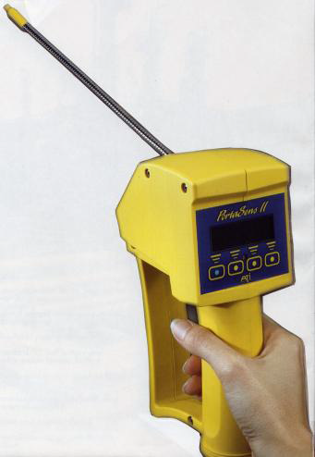
Evaluation of Chemical Exposure in Environment
＜Test Method＞
Chemical solution Peracetic acid formulation
Measurement equipment
Portable Gas Detector C16 Porta SensⅡ
① 00-1042 Hydrogen Peroxide, 0-10/100 PPM
② 00-1704 Peracetic Acid, 0-1/5 PPM
③ 00-1045 Acetic Acid, 0-100/500 PPM
Manufactured by ATI Technology
Measurement method
For a standard cycle, the gas concentration
① from the exhaust during a cycle
② in the chamber immediately after the cycle.
Notes:
39

Slide 40
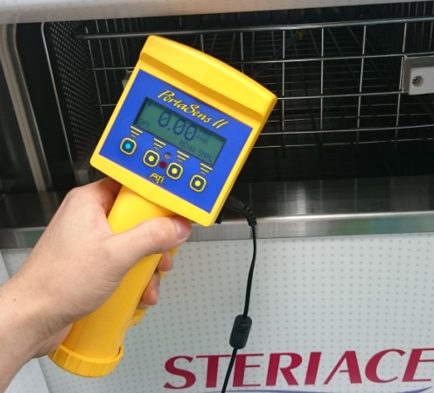
Evaluation of Chemical Exposure
From the exhaust during the cycle, all 3 gases were measured below the detection limits.
From the chamber immediately after the cycle, all 3 gases were also measured below the detection limits.
Gas measured | Concentration measured（max）
 | ①Exhaust | ②In chamber
Hydrogen peroxide | <0.2ppm | <0.2ppm
Peracetic acid | <0.02ppm | <0.02ppm
Acetic acid | <2ppm | <2ppm
Reference values Various exposure limits（TLV-TWA*andAEGL-1**）
①Hydrogen peroxide concentration <1ppm*
②Peracetic acid concentration <0.17ppm**
③Acetic acid <10ppm*
Notes:
40

Slide 41
Conclusion
For the new low temperature PAA gas steriliser:
It has been experimentally shown that plasma causes generation of O radicals and degradation of peracetic acid.
Even though an equilibrium mixture of peracetic acid and hydrogen peroxide is used, germicidal efficacy is mainly due to the peracetic acid component.
The expected sporicidal efficacy for half cycles was observed even when tested in narrow channels.
The concentration of the three major components in the environment used were all found to be below safety limits.
Although there is a need to collect more information on material compatibility with medical equipment, residue and others, this PAA steriliser can be expected to be a valuable new gas steriliser.

Slide 42
Thank you very much for your kind attention

