Slide 1


Creation of an electronic platform dedicated to ancillary sets: a French example
Ms. Malki Myriam – Dr. Dauchot Jean Marc
CHI Andre Grégoire - Montreuil
7-10 October 2015

Slide 2
Outline
Challenges of the ancillary set circuit
Inter-ancillary project: aims and approach
Stock-taking and outlook
Conclusion

Slide 3
I. Challenges of the ancillary set circuit

Slide 4
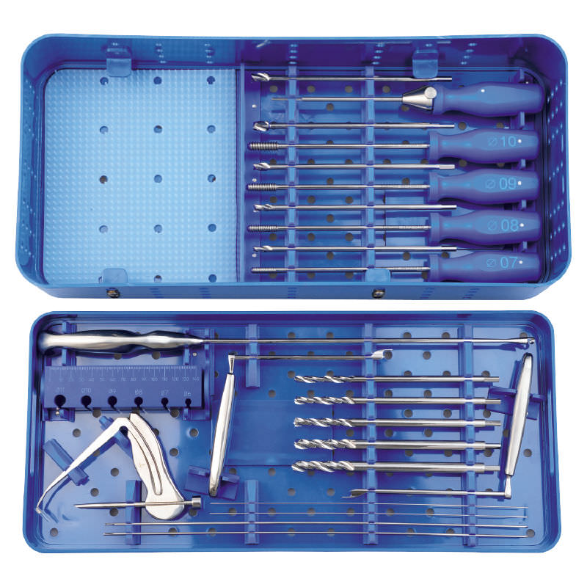
What is an ancillary set?
I
II
III
IV
From the latin “ancillaris“, meaning “servant”
Surgical equipment on an occasional loan or for a defined period of time
Subject to EC marking
Meets the need for new surgical techniques
No specific French regulatory text

Slide 5
Complexity of the ancillary set circuit:
I
II
III
IV
  Several people involved within the hospital itself:
  Surgeon
  Circulator
  Sterilization unit
  Operating room nurse
  Hospital pharmacist
  According to the UNAIBODE and AFS study carried out in 2013:
  Delivery of the ancillary set less than 48 hours before the procedure: 76% of cases
  No documentation provided: 25% of cases
  Quality of the documentation: incomplete in 30% of cases
  Missing information form: 26% of cases
  Procedure related to the management of an ancillary set: 74% of facilities
UNAIBODE: National Union of the Association if State-Certified Operating Room Nurses
AFS: French Sterilization Agency

Slide 6
Risks linked to the poor management of ancillary sets:
I
II
III
IV
  Infectious risk+++
  Non-compliant traceability
  Logistics problem
    No control over the dispatch, sterilization, etc. processes for the operating table
    No computer-based traceability possible
  Surgeon and OR nurses discover the instruments on the day of the procedure
  Verification of the composition of the ancillary is not always possible
Creation of an IT platform dedicated to managing ancillary sets
ATNC: Unconventional transmissible agent
IBODE: State-certified operating room nurse

Slide 7
II. Inter-ancillary project: aims and approach
7

Slide 8
Implementation of the platform…
I
II
III
IV
Creation of a multi-disciplinary working group:
  Software publishers
  Hospital pharmacists
  Specialized pharmaceutical industries
  Orthopedic surgeons
  Operating room nurses
Definition of the inter-ancillary project scope
Decision to create an electronic platform dedicated to ancillary sets

Slide 9

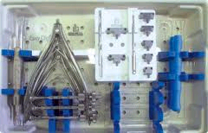
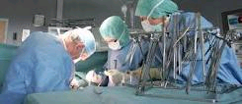


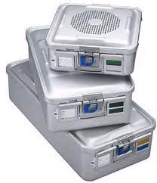
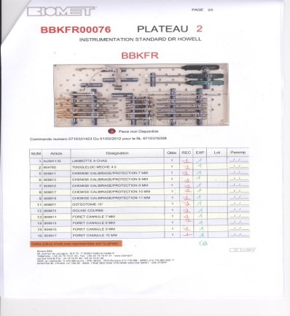
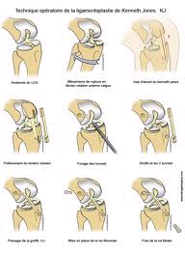
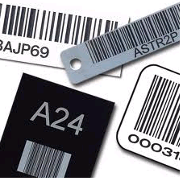
Platform principle
I
II
III
IV
Inter-ancillary platform
Vidéo

Slide 10
Platform test: principle
I
II
III
IV
20 ancillary sets described in the platform test:
  List of instruments
  Photos
  Videos
  Operating protocol
  Washing method, sterilization method
Creation of the software publisher/hospital center pair:
  Platform/sterilization software compatibility
  Recovery of the ancillary set data available on the platform
  Ease of use and downloading

Slide 11
Test results
I
II
III
IV
During this test phase, two thirds of the hospitals reached a recovery rate of 100%
At the end of 2013, standardization of the exchanges: 100% recovery rate for all of the facilities

Slide 12
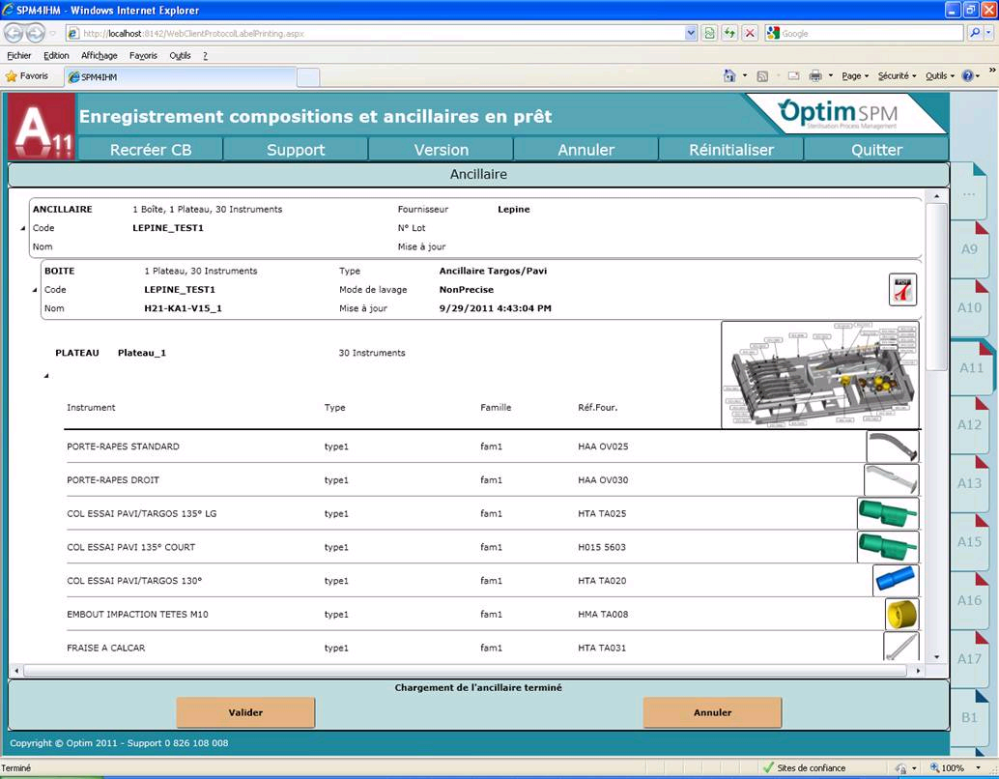
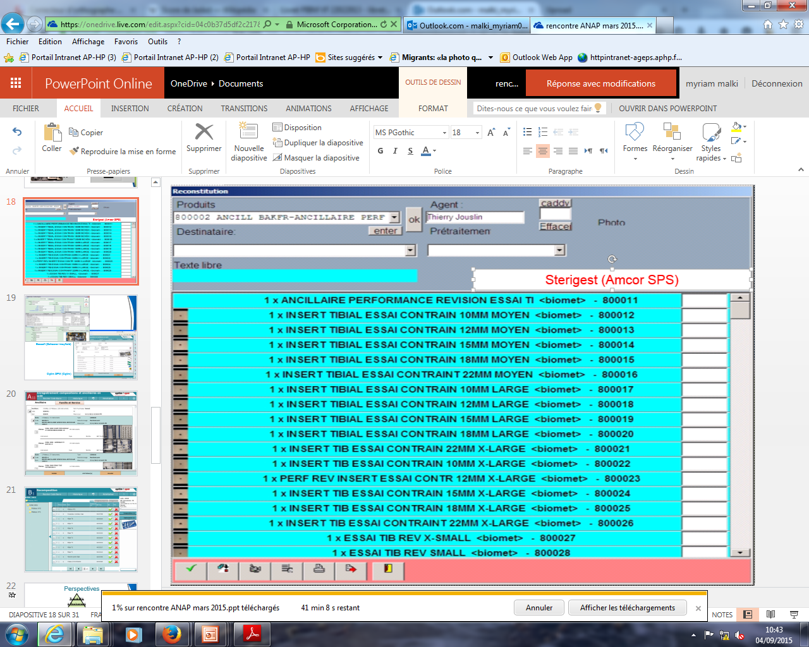
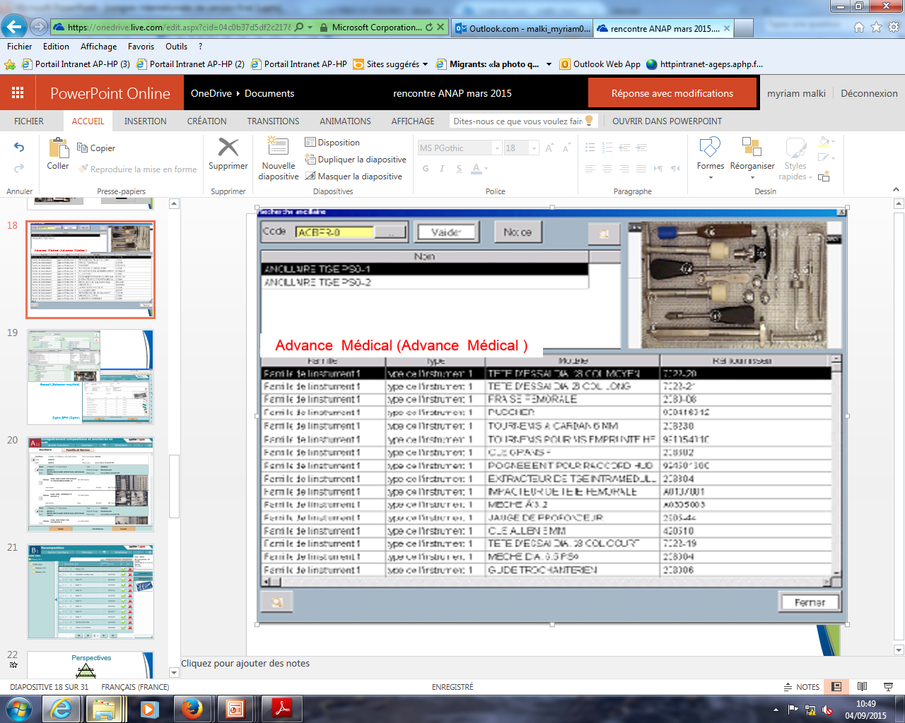
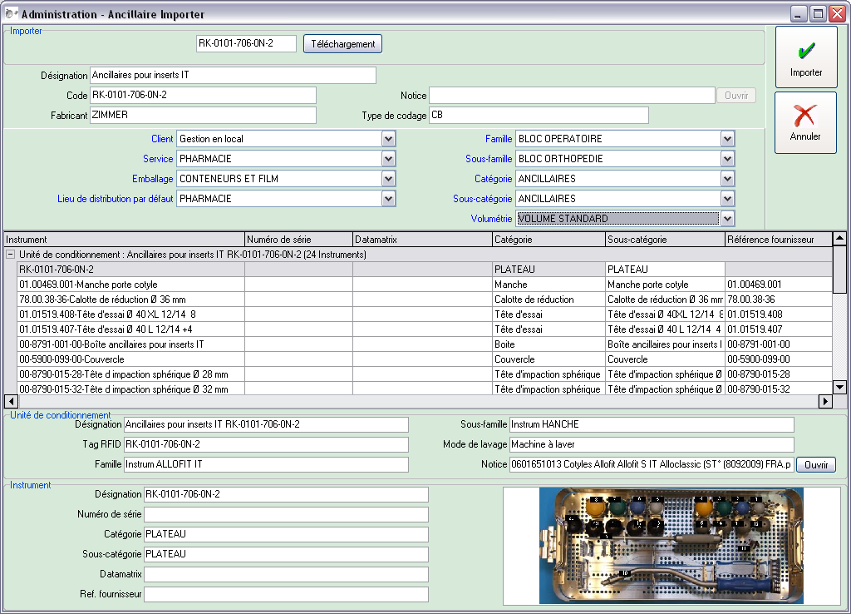
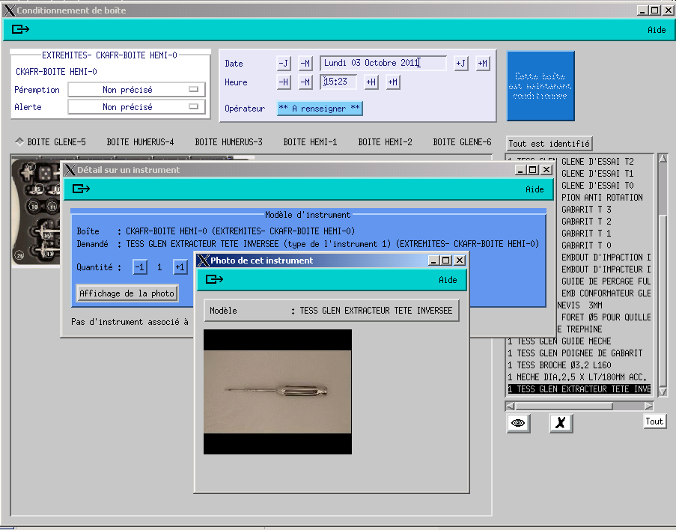
Illustration of the results
I
II
III
IV

Slide 13
III. Stock-taking and outlook

Slide 14
Outlook: the platform
I
II
III
IV
Instrument
traceability
Implants
LPPR code
Delivery slip
Traceability
Forms
Returns logistics
Ancillary set platform principle
Feasibility, interest
14

Slide 15
Outlook
I
II
III
IV
Production start?
yes
One or several platform(s)?
A single national platform
Who manages the platform?
A non-profit association
Financing?
Annual membership fees
Learned societies?
AFS
SOFCOT
SNITEM
UNAIBODE
Name?
Inter-ancillaries
15

Slide 16
Project inventory
I
II
III
IV
  Launch of the platform in January 2014
  Data recovery rate: 100%
  750 ancillary sets available on the platform
  80 participating hospital centers
  9 software publishers
  12 industrial companies
  150 ancillary set downloads per month
16

Slide 17
Outlook: forms
I
II
III
IV
Facilitates the transfer of information between the industrial company and
the hospital center
Identical questions regardless of the sterilization software used
17

Slide 18
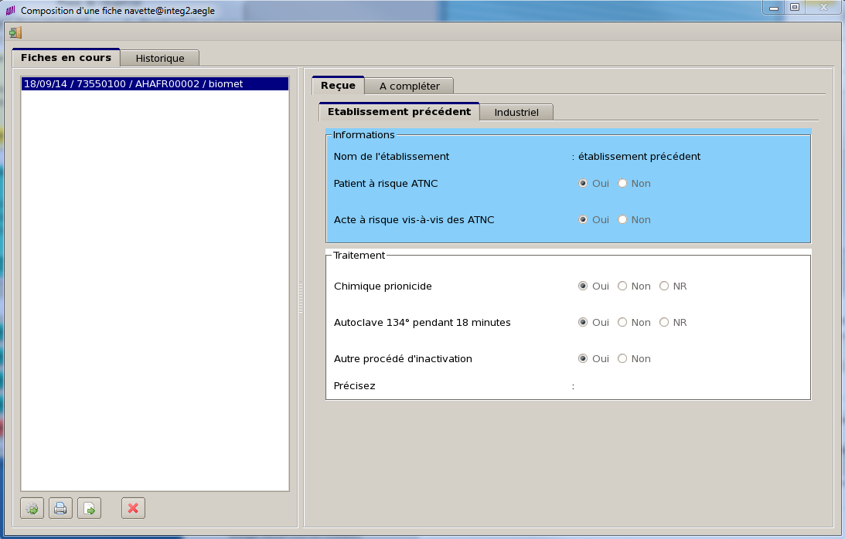
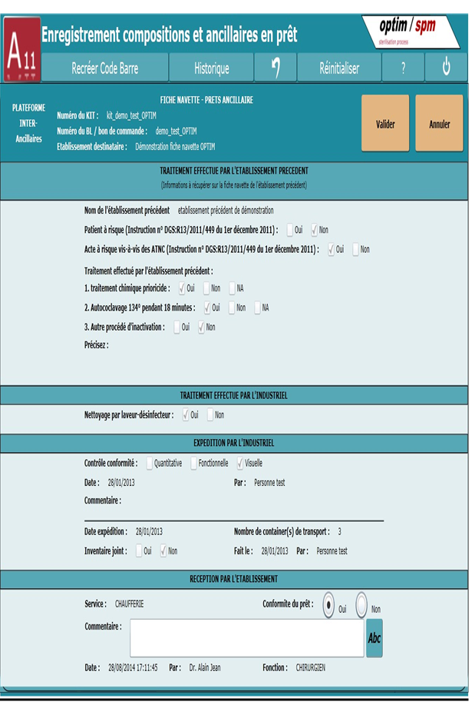
Example of form used
I
II
III
IV
18

Slide 19
Outlook
I
II
III
IV
Instrument
traceability
Ongoing
Implants
LPPR code
Delivery slip
Traceability
Forms
Returns logistics
Completed
Principe plateforme ancillaires
Ancillary platform principle
faisabilité, intérêt
Feasibility, interest
19

Slide 20
IV. Conclusion

Slide 21
Conclusion
I
II
III
IV
Universal system:
  Participation of bordering countries: Belgium, Switzerland, Luxembourg…
Affordable:
  Hospital center: 20€/year
  Industrial company: 500€/year
  Software publisher: 500€/year
Optimization of the ancillary set lending circuit:
  Improved traceability
  Securement
Sustainability of the project:
  Increase in hospital center participants
  Increase in the ancillary sets described on the platform

Slide 22
























Acknowledgements
Learned societies:
Software publishers:
Laboratories:

