Slide 1
Low temperature sterilization of flexible endoscopes
Protection from detrimental impacts of the sterilant during the process
Dr. Tronje von dem Hagen, Lübeck
tronje@vondemhagen.com
An increasing number of flexible endoscope applications ask for sterile conditions.
Practice from the last years in reprocessing using low temperature sterilization processes with chemical sterilizing agents show, that repeated process conditions finally can impair the functional or mechanical integrity of the endoscope due to accumulation of small deteriorating impacts.
Respective limitations of sterilization cycles by the endoscope manufacturers and extra costs for frequent inspection, maintenance and repair ask for technical improvements; some of them have been analyzed, implemented , and successfully tested.

Slide 2

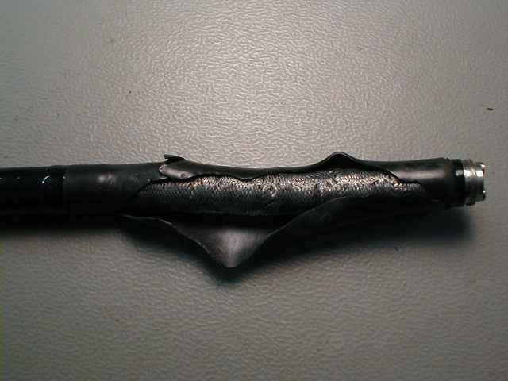
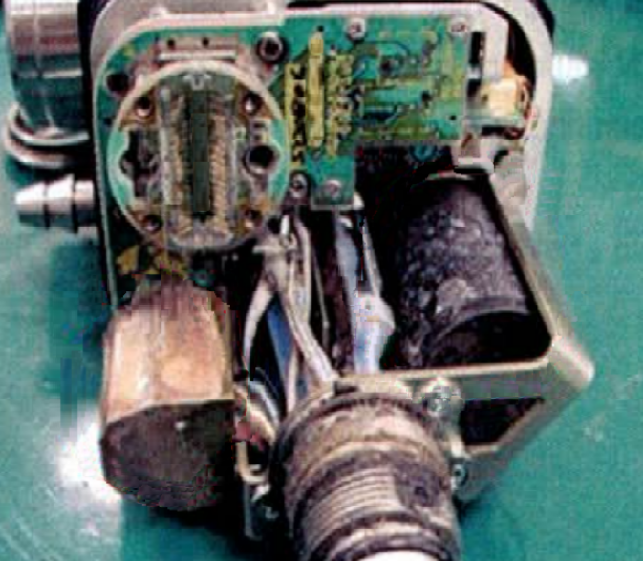

Typical damages following (frequent) low temperaturer sterilization cycles (1)
7-10 oct. 2015
Rupture of protective flexible tube at distal end due to missing ETO cap in a vacuum process
Corrosion and detrimental residues due to ingress of aggressive sterilant into the inside

Slide 3
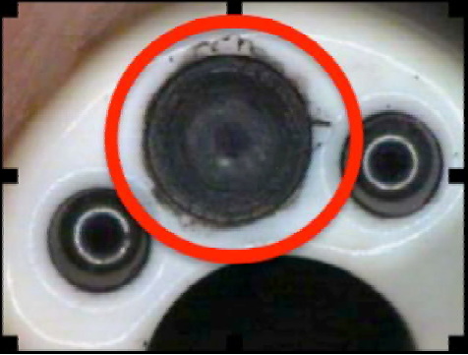
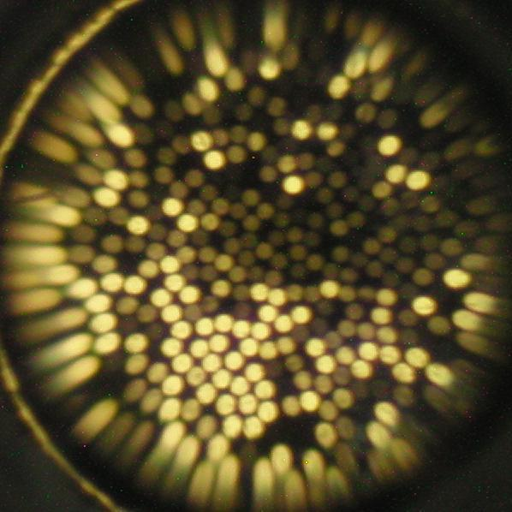
Typical damages following frequent low temperaturer sterilization cycles (2)
7-10 oct. 2015
Deterioration of adhesive around distal front lens due to chemical incompatibility to the sterilant
Damage of light guide fibres, e.g. due to penetration of liquids through defective front lens sealing

Slide 4
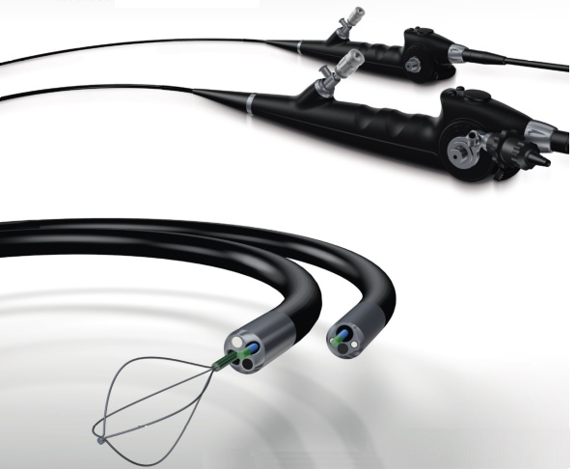
Specific design aspects of endoscopes (1)
7-10 oct. 2015
Endoscope outer surfaces
(need to be reprocessed / sterilized):
(Cobra Vision, Richard Wolf)

Slide 5
Specific design aspects of endoscopes (1)
7-10 oct. 2015
Endoscope outer surfaces
(need to be reprocessed / sterilized):
Control head with handles
Umbilical cable /universal cord
Connectors for media supplies
Ports for insertion of instruments
Insertion tube
Optical components (e.g. front lenses)
Operating channels (inner surfaces)
(Cobra Vision, Richard Wolf)

Slide 6
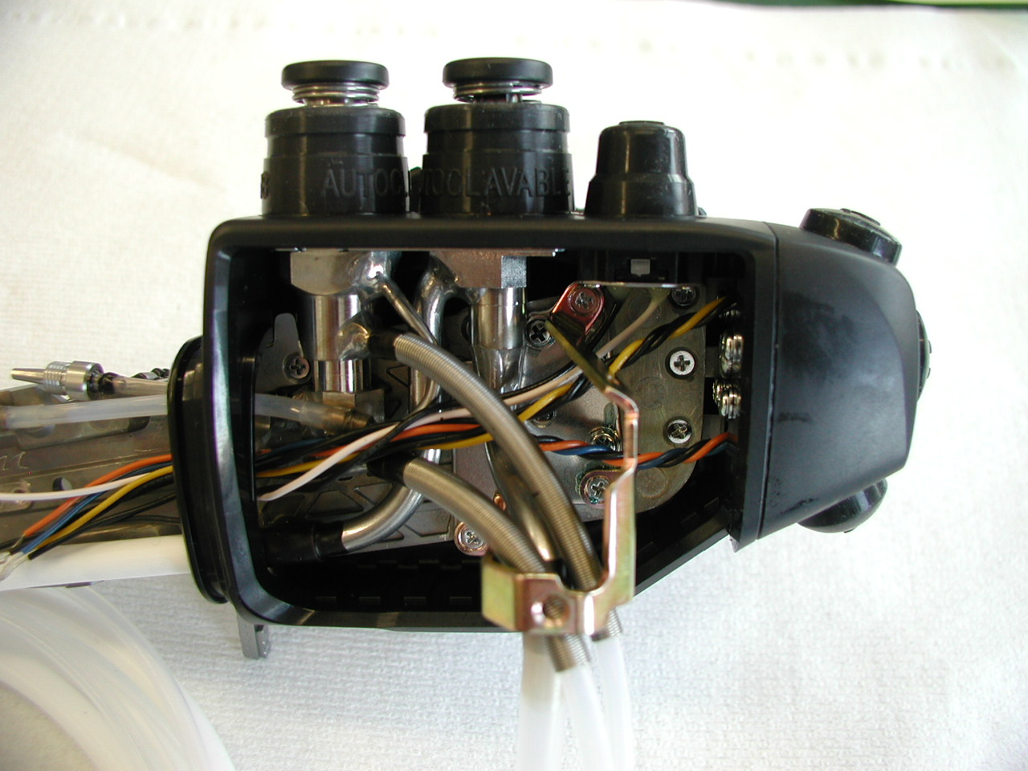
Specific design aspects of endoscopes (2)
7-10 oct. 2015
Endoscope housing Inside
(hermetically sealed, no need to be reprocessed):

Slide 7
Specific design aspects of endoscopes (2)
7-10 oct. 2015
Endoscope housing Inside
(hermetically sealed, no need to be reprocessed):
Manipulation mechanics
Angulation control strings
Light guides
Channel tubes (outer surfaces)
Valve housings
Electrical connectors
Electronic parts

Slide 8


Specific aspects to be considered for reprocessing
Possible defects, mistakes, and residual risks
7-10 oct. 2015
Sealing of endoscope housing defective (leak):
reprocessing chemicals may penetrate and can
damage inner parts (residues, chemical reaction)
Vacuum phases during sterilization generate a high
pressure difference between inside and outside;
internal overpressure (> 300mbar) may burst the
very thin and flexible protective tube at the distal
end of the insertion tube.
Missing ETO-Cap during sterilization using processes
with vacuum phases (user mistake);
rupture of protective tube
Sneaky buildup of defects and residuals due to
individually neglectable impacts at each sterilization
cycle, becoming detectable and relevant for operation
only upon accumulation after 100 cycles or more.
Leak test is mandatory before reprocessing,
test device to be connected to leak test port
(internal overpressure max. 300 mbar)
The „ETO-Cap“ to be connected to the leak test port
opens the spring loaded valve and allows pressure
equilibration between inside and outside of the
endoscope housing
Training of the staff;
in case of rupture:
Endoscope out of order for repair at customer service
Material compatibility tests in co-operation between
the manufacturers of the endoscope and the sterilizer;
Limitation of number of reprocessing cycles until
scheduled maintenance.
100 cycles

Slide 9
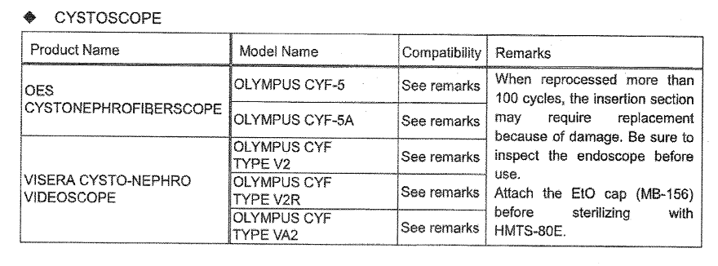
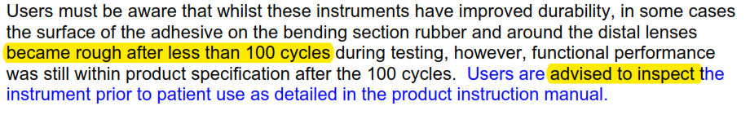
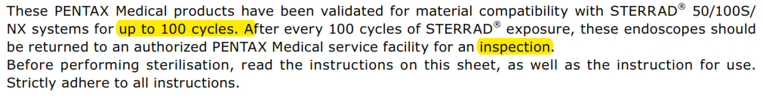
Consequences for routine operation (current situation)
Example 1
7-10 oct. 2015
100 cycles,
inspect
EtO cap
Example 2
Example 3
Note: An endoscope might be used and reprocessed some hundreds of times a year.

Slide 10
Critical positions for ingress of sterilizing agents are:
The distal front of the insertion tube
endoscope manufacturers shall improve compatibility of adhesives and sealing coatings
(permanent task)
7-10 oct. 2015
The Leak test port intentionally opened by the EtO-cap during vacuum sterilization cycles
Technical options to improve:
a) integrate a non-return valve (or any other) into the ETO- Cap to allow evacuation,
but to block ingress of aggressive chemical processing (sterilizing) agents
(to be designed by the sterilizer manufacturer)
b) integrate a non-return valve (or any other) into the leak test port
(to be designed by the endoscope manufacturer)

Slide 11
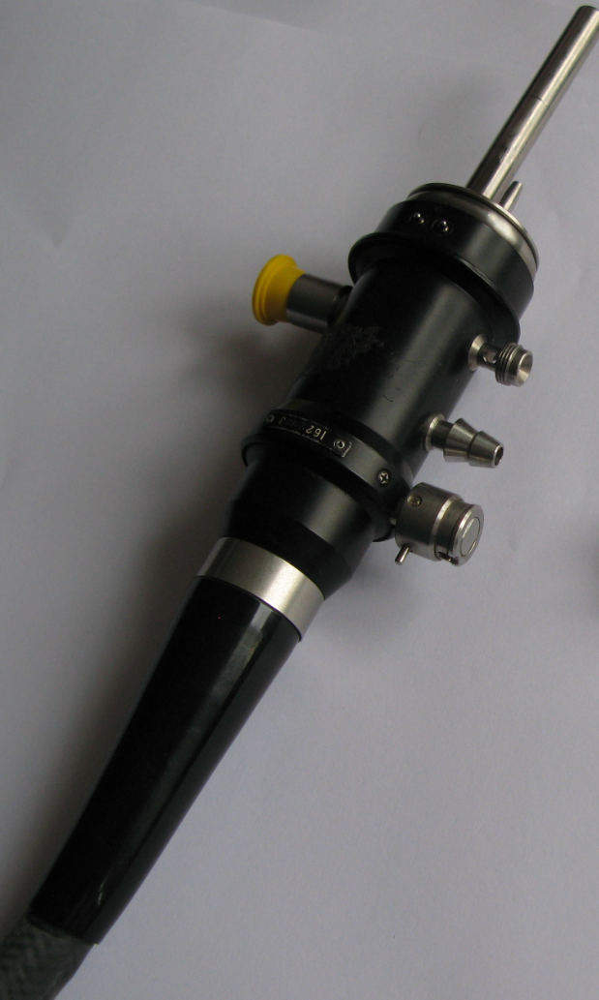


Design sketch of a Sterilization Valve
combined with the EtO-Cap (schematic)
7-10 oct. 2015
EtO-CAP
Leak test port
Non-return valve
on top
Symbol
New Sterilization Valve

Slide 12
Application of a sterilization valve
1. Example: STERIVIT- high/low pressure process
NO
7-10 oct. 2015
pressure
[bar]
desorption phase
ca. 8 - 10 hrs
Holding time
6
6,5 bar
Use of a sterilization valve
not recommended for EtO
(keep the EtO-Cap)
very high pressure differences
no restrictions are known for EtO,
no concerning information from
practice
5
4
3
2,7 bar
2
1
time
0
ca. 10 - 12 hrs

Slide 13


Application of a sterilization valve
2. Example: STERRAD 100 NX process
YES
7-10 oct. 2015
Pressure [mbar]
Use of a non return valve
recommended for H2O2
(with or without plasma)
no overpressure during process
relevant detrimental impact
of H2O2 experienced in practice
ventilation after aeration phase?
Air injection
conditionning
aeration
aeration
1000
H2O2 diffusion
H2O2 diffusion
- 960 mbar
100
10
Process pressure inside the
sterilizer chamber
(outside endoscope housing)
Pressure inside endoscope
housing (valve adjusted to
open/close at ca. 50 mbar)
50 mbar
1
plasma
plasma
0.1
time

Slide 14


Application of a sterilization valve
3. Example: LTSF-process (EN 14180)
YES
7-10 oct. 2015
Use of a sterilization valve
recommended for LTSF
no overpressure during process
relevant detrimental impact of
formaldehyde /water in practice
ventilation after aeration phase?
Pressure
conditionning
Desorption & drying
Po
air
1013
formaldehyde + steam steam
- 790 mbar
Process pressure inside the
sterilizer chamber
(outside endoscope housing)
Pressure inside endoscope
housing (valve adjusted to
open/close at ca. 170 mbar)
200
Holding time
170 mbar
50
time

Slide 15
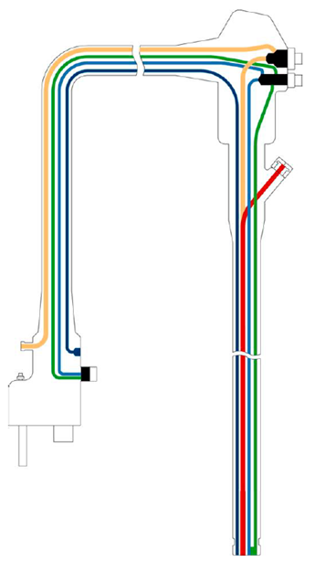
Ventilation after aeration phase (end of cycle)?
7-10 oct. 2015
Retaining vacuum inside the endoscope housing
after end of cycle and storage at these conditions
for some time may create problems for specific
designs of the endoscopes (e.g. mechanical push
buttons under a flexible sealing plastic cap).
Options:
Use of a double non-return valve
Manual lifting of the non-return valve
Use of a servo valve (venting the inner volume
at ambient pressure)
Solution is influenced by the process parameters,
to be investigated by the sterilizer manufacturer.
(single) non-return valve
Double non-return valve

Slide 16
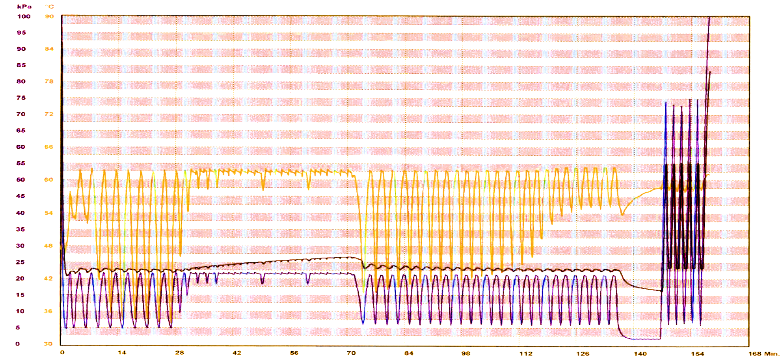
Measured cycle profile for LTSF process 60°C matachana 130 LF / WEBECO FA95
using double non return valve LTSF-valve (+170 / -170 mbar)
7-10 oct. 2015
Residual vacuum: 170 mbar
Chamber temperature
Chamber pressure
Pressure inside endoscope housing

Slide 17
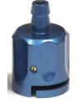
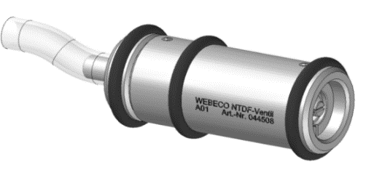
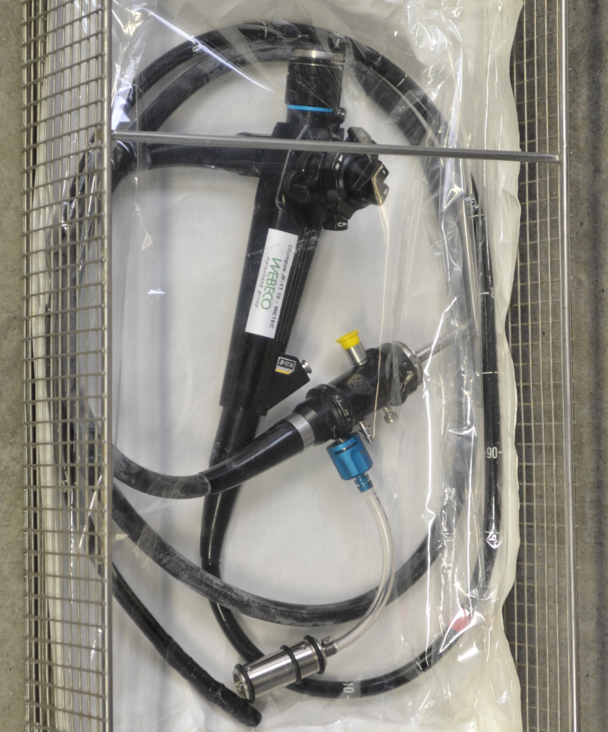




Example from practice (specific LTSF-valve [double non-return], matachana-WEBECO)
7-10 oct. 2015
Type O
Type W
Type S
Endoscope specific
Coonector
Type F
Type P
Sterilization Valve

Slide 18
Low temperature sterilization of flexible endoscopes
Protection from detrimental impacts of the sterilant during the process
Summary
Critical design characteristics of flexible endoscopes have been analyzed and technical options could be found to eliminate identified impacts.
Technical solutions for most relevant LTS processes as applied in the market and possible improvements in general have been discussed.
Some design options and practical solutions have been presented and their functionality for LTSF sterilization has been demonstrated by experimental data using a double non-return valve available in the market.
Experience from recent years has proven proper function and reliability of this protective valve, which is recommended by an increasing number of endoscope manufacturers.
Use of the valve could verify significant reduction of maintenance and repair costs.
7-10 oct. 2015

Slide 19
Low temperature sterilization of flexible endoscopes
Protection from detrimental impacts of the sterilant during the process
Dr. Tronje von dem Hagen, Lübeck
tronje@vondemhagen.com
Thank you very much
for your attention
7-10 oct. 2015

